Slide 1

FAIR Research Software Metrics
FAIR-by-Design workshop
February 19th 2024
Neil Chue Hong and Mario Antonioletti, University of Edinburgh

Slide 2


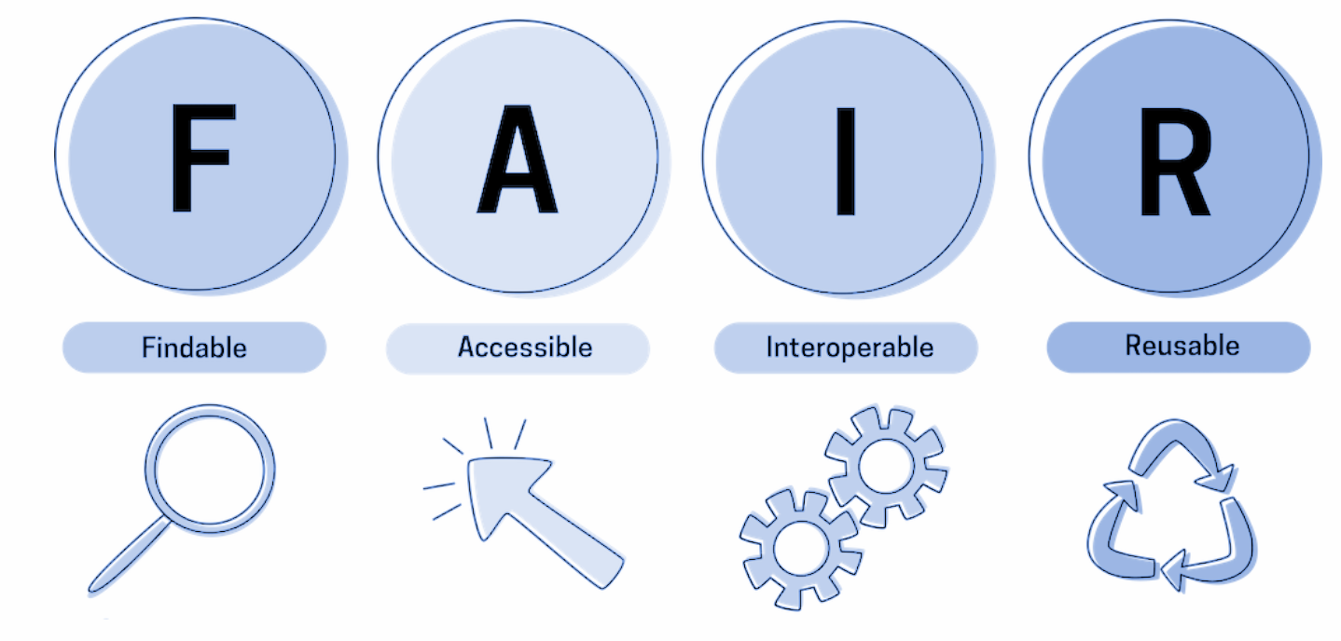
FAIR IMPACT Objectives
Support the implementation of FAIR-enabling practices, tools and services across scientific communities
From ‘Making data FAIR’ blog
FAIRness assessment challenge
1st meeting
2 October 2023

Slide 3




FAIR Principles for Research Software (FAIR4RS)
A joint RDA Working Group, FORCE11 Working Group, and Research Software Alliance (ReSA) Taskforce.
250 members, 80 active contributors.
Coordinating of a range of existing community-led discussions on:
How to define and effectively apply FAIR principles to research software,
How to achieve adoption of these principles.
Introducing the FAIR Principles for research software (Scientific Data)
FAIR Principles for Research Software (FAIR4RS Principles) v1.0 (RDA)
FAIR principles for research software
Implementation guidelines
Adoption examples
Sep 2020
Oct 2022
M6
M12
M18

Slide 4
FAIR4RS Principles v1.0
F: Software, and its associated metadata, is easy for both humans and machines to find
F1. Software is assigned a globally unique and persistent identifier.
F1.1. Components of the software representing levels of granularity are assigned distinct identifiers.
F1.2. Different versions of the software are assigned distinct identifiers.
F2. Software is described with rich metadata.
F3. Metadata clearly and explicitly include the identifier of the software they describe.
F4. Metadata are FAIR, searchable and indexable.
A: Software, and its metadata, is retrievable via standardized protocols.
A1. Software is retrievable by its identifier using a standardized communications protocol.
A1.1. The protocol is open, free, and universally implementable.
A1.2. The protocol allows for an authentication and authorization procedure, where necessary.
A2. Metadata are accessible, even when the software is no longer available.
I: Software interoperates with other software by exchanging data and/or metadata, and/or through interaction via application programming interfaces (APIs), described through standards.
I1. Software reads, writes and exchanges data in a way that meets domain-relevant community standards.
I2. Software includes qualified references to other objects
R: Software is both usable (can be executed) and reusable (can be understood, modified, built upon, or incorporated into other software).
R1. Software is described with a plurality of accurate and relevant attributes.
R1.1. Software is given a clear and accessible license.
R1.2. Software is associated with detailed provenance.
R2. Software includes qualified references to other software.
R3. Software meets domain-relevant community standards.
Chue Hong, N. P., et al. (2022). FAIR Principles for Research Software version 1.0. (FAIR4RS Principles v1.0). Research Data Alliance. DOI: https://doi.org/10.15497/RDA00068

Slide 5
FAIR metrics for software
Assessing FAIRness of software principally for self-improvement, not comparison
Existing related work on FAIR metrics for data, and software metrics
FAIRMetrics.org, FAIR Metrics for EOSC, FAIRsFAIR FAIRness of software, FAIR Metrics for FAIR Software (NL), CHAOSS
In FAIR-Impact, we are investigating:
How suitable are existing tools for assessing FAIRness, when applied to software? E.g. howfairis, FAIR enough metrics, F-UJI, Somef
What are suitable metrics to help improve the findability, accessibility, interoperability and reusability of software?
Metrics often related to metadata
Notes:
EOSC Compliance Assessment Toolkit from FAIRCORE4EOSC

Slide 6
FAIR metrics
A good metric (from fairmetrics.org) should be:
Clear: anyone can understand the purpose of the metric
Realistic: it should not be unduly complicated for a resource to comply with the metric
Discriminating: the metric should measure something important for FAIRness; distinguish the degree to which that resource meets that objective; and be able to provide instruction as to what would maximize that value
Measurable: the assessment can be made in an objective, quantitative, machine-interpretable, scalable and reproducible manner, ensuring transparency of what is being measured, and how.
Universal: The metric should be applicable to all digital resources.

Slide 7
Metrics for FAIR software assessment
How do we measure the “FAIR-ness” of software?
Some principles are “precise” (e.g. “clear and accessible license)
Some principles are “open” (e.g. “meets domain-relevant community standards)
Some principles are easy to measure but hard to meet (e.g. “software includes qualified references to other objects”)
Some principles are hard to measure but easy to “meet” (e.g. “software is described with rich metadata”)
FAIR is not binary, it is an indicator of progression
RDA FAIR4RS WG. (2022). FAIR Principles for Research Software (FAIR4RS Principles) (1.0). Zenodo. https://doi.org/10.15497/RDA00068 Chue Hong, N., Breitmoser, E., Antonioletti, M., Davidson, J., Garijo, D., Gonzalez-Beltran, A., Gruenpeter, M., Huber, R., Jonquet, C., Priddy, M., Shepherdson, J., Verburg, M., & Wood, C. (2023). D5.2 - Metrics for automated FAIR software assessment in a disciplinary context (1.0 - DRAFT not yet approved by the European Commission). Zenodo. https://doi.org/10.5281/zenodo.10047401

Slide 8
Automated FAIR software assessment
Software metrics can be applied at three main levels: source code, software project, and repository
The same metric will have different implementations depending on the type of software and the field
While metrics and assessment methods are expected to remain the same, the criteria for compliance levels will change as adoption of FAIR principles increases, and infrastructure, tools and guidance improve
Field | Description
Metric Identifier | The local identifier of the metric (FRSM-XX) FRSM: FAIR Research Software Metric.
Metric Name | Metric name in a human readable form.
Description | The definition of the metric, including examples.
FAIR4RS Principle | The FAIR4RS principle(s) most related to the metric.
RSMD Recommendation | The FAIR-IMPACT RSMD recommendation(s) most related to the metric
Assessment | Requirements and methods to perform the assessment against the metric. This includes a suggested compliance level (essential / important / useful), based on the concepts introduced by the FAIR Data Maturity Model Working Group (2020). Criteria at each level will change as adoption of FAIR increases.
Comments | Further notes associated with the implementation of the metric, which may include related resources, constraints and limitations.
D5.2 - Metrics for automated FAIR software assessment in a disciplinary context (1.0 - DRAFT not yet approved by the European Commission). Zenodo. https://doi.org/10.5281/zenodo.10047401

Slide 9
FAIR Research Software Metrics
Identifier | Name
FRSM-01 | Does the software have a globally unique and persistent identifier?
FRSM-02 | Do the different components of the software have their own identifiers?
FRSM-03 | Does each version of the software have a unique identifier?
FRSM-04 | Does the software include descriptive metadata which helps define its purpose?
FRSM-05 | Does the software include development metadata which helps define its status?
FRSM-06 | Does the software include metadata about the contributors and their roles?
FRSM-07 | Does the software metadata include the identifier for the software?
FRSM-08 | Does the software have a publicly available, openly accessible and persistent metadata record?
FRSM-09 | Is the software developed in a code repository / forge that uses standard communications protocols?
Identifier | Name
FRSM-10 | Are the formats used by the data consumed or produced by the software open and a reference provided to the format?
FRSM-11 | Does the software use open APIs that support machine-readable interface definition?
FRSM-12 | Does the software provide references to other objects that support its use?
FRSM-13 | Does the software describe what is required to use it?
FRSM-14 | Does the software come with test cases to demonstrate it is working?
FRSM-15 | Does the software source code include licensing information for the software and any bundled external software?
FRSM-16 | Does the software metadata record include licensing information?
FRSM-17 | Does the software include provenance information that describe the development of the software?
D5.2 - Metrics for automated FAIR software assessment in a disciplinary context (1.0 - DRAFT not yet approved by the European Commission). Zenodo. https://doi.org/10.5281/zenodo.10047401

Slide 10
From metrics to measurement (FRSM-01)
Field | Generic Metric |  | CESSDA Implementaton
Metric Identifier | FRSM-01 |  | FRSM-01-CESSDA
Metric Name | Does the software have a globally unique and persistent identifier? |  | Does the software have a globally unique and persistent identifier?
FAIR4RS Principle | F1: Software is assigned a globally unique and persistent identifier. R3: Software meets domain-relevant community standards. |  | F1: Software is assigned a globally unique and persistent identifier. R3: Software meets domain-relevant community standards.
RSMD Recommendation | RSMD-3.3 |  | RSMD-3.3
Assessment | Requirements | Software identifier List of globally unique identifier schemes | Software releases of open source components to be published in Zenodo DOI handle
 | Method | Check if the software identifier is based on a suitable identifier scheme, and test it can be resolved. | Check that an established identifier scheme from the CESSDA Software Publication polices is used to identify software.
 | Essential | Software has a human and machine-readable unique identifier that is resolvable to a machine-readable landing page and follows a defined unique identifier syntax. | A version-dependent DOI must be added in the repository’s README as the recommended citation
 | Important | Identifier uses an identifier scheme that guarantees globally uniqueness and persistence. | Releases use the Semantic Versioning 2.0.0 notation
 | Useful | Identifier scheme is commonly used in the domain. | Only Major and Minor releases are assigned DOIs
Comments | The type of identifier assigned will often depend on the type of repository that the software is deposited in, for example a URL for GitHub, DOI for Zenodo, or SWHID for Software Heritage. |  | As described in the CESSDA ERIC Persistent Identifier Policy, CESSDA tools and services accept: DOI, Handle (including ePIC-handles), URN, ARK (fulfilling principle 10 of the CESSDA Data Access Policy).

Slide 11
From metrics to measurement (FRSM-06)
Field | Generic Metric |  | CESSDA Implementaton
Metric Identifier | FRSM-06 |  | FRSM-06-CESSDA
Metric Name | Does the software have a globally unique and persistent identifier? |  | Does the software include metadata about the authors and their roles?
FAIR4RS Principle | F2: Software is described with rich metadata. R3: Software meets domain-relevant community standards. |  | F1: Software is assigned a globally unique and persistent identifier. R3: Software meets domain-relevant community standards.
RSMD Recommendation | RSMD-5.1, RSMD-5.2, RSMD-5.3, RSMD-5.4, RSMD-5.5, RSMD-5.6. RSMD-5.7. RSMD-5.8 |  | RSMD-3.3
Assessment | Requirements | Software source code Software identifier | Software source code Software identifier
 | Method | Check if the software and/or software identifier has machine readable descriptive metadata associated with it that include contributors and roles. | Check that the CITATION and/or CONTRIBUTORS files exist and Zenodo metadata is present
 | Essential | The software includes metadata about the contributors | A CITATION and/or CONTRIBUTORS files is present in the root of the repository.
 | Important | The software includes citation metadata that includes all contributors and their roles. This includes ORCIDs when contributors have them. | Author details (including ORCIDs) are present in the corresponding Zenodo record. ORCIDs are present for authors in the CITATION.cff file.
 | Useful | The citation metadata includes the proportional credit attributed to each contributor | N/A
Comments | There are several common places for contributor metadata to be found, including README files, CodeMeta or CFF files, in the code repository metadata, or in the software identifier metadata. It may also be directly embedded in software source code files. Criteria for which roles are included is normally defined by the community. |  | Authorship criteria should follow the CESSDA Publication Policy & Procedures (CESSDA, 2020). CESSDA uses Citation File Format for recording authorship, e.g. CDC-Searchkit citation.

Slide 12
Measuring the FAIRness of your software
Tooling for assessing software FAIRness is still relatively new
Paper based assessment:
For each of the FAIR Research Software Metrics, consider:
How would you measure this, in your domain?
What would be considered essential/important/useful?
How does your current software software compare?
Are there any FAIR Principles for Research Software that are harder to meet?

Slide 13



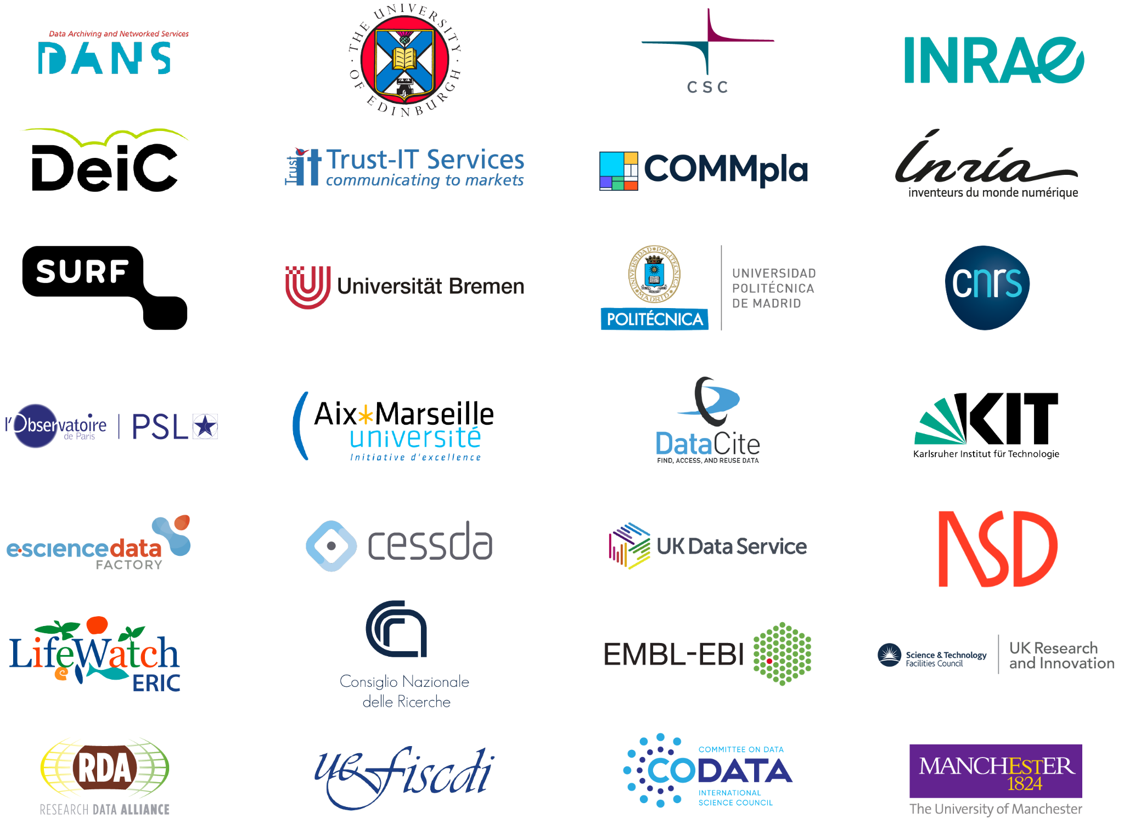


The Consortium

Slide 14


